Slide 1


Nuno Ferreira
August 2024

Slide 2
Outline
Executive Summary
Introduction
Methodology
Results
Conclusion
Appendix

Slide 3
Executive Summary
Summary of methodologies
Data collection (using API’s and web scraping)
Data wrangling
EDA with SQL
EDA with data visualization
Building an interactive map with Folium
Building a Dashboard with Plotly Dash
Predictive analysis (Classification)
Summary of all results
Exploratory data analysis results
Interactive analytics demo in screenshots
Predictive analysis results

Slide 4
Introduction
Project background and context
In this project, we aim to predict the successful landing of the Falcon 9 first stage.
SpaceX advertises Falcon 9 rocket launches at a cost of 62 million dollars, significantly lower than the industry average of 165 million dollars offered by other providers.
The cost-effectiveness is primarily attributed to SpaceX's ability to reuse the first stage. By accurately predicting the success of the first stage landing, we can determine the potential cost of a launch.
This information can be invaluable for companies looking to bid against SpaceX in the competitive rocket launch market.
Problems you want to find answers
Identify the correlation between rocket launch success and various launch characteristics such as launch site and rocket type.
Identify the optimal predictive model for determining rocket landing outcome.

Slide 5

Section 1

Slide 6
Methodology
Executive Summary
Data collection methodology
SpaceX API and web scraping to collect Falcon 9 historical launch records from a Wikipedia page titled List of Falcon 9 and Falcon Heavy launches.
Perform data wrangling
Augmented data with a Boolean feature that identifies the landing outcome.
Perform exploratory data analysis (EDA) using SQL and visualization
Visualization using scatter charts and bar charts to show relationships between features to identify patterns in data.
Perform interactive visual analytics using Folium and Plotly Dash
Folium to plot all launch sites on a map. Plotly Dash to create an interactive dashboard to visualize success rate in a pie chart and a scatter chart to show the relationship between outcome and payload for the different booster versions.
Perform predictive analysis using classification models
Determine optimal hyperparameter for SVM, Classification Trees and Logistic Regression models.

Slide 7
Data Collection
The data was collected using 2 different methods:
SpaceX API:
Using get request to the SpaceX API, we retrieved the data for the rockets, launchpads, payloads, cores, flight numbers and dates. Decoded the response content as a Json using json() function call and parsed it to a pandas dataframe using json_normalize(). Cleaned the data, checked for missing values and filled in missing values in payloadmass with its mean. Saved the data frame to a csv file for later analysis.
Wikipedia web scraping:
Using BeautifulSoup performed web scraping from Wikipedia for Falcon 9 launch records. Extracted the launch records as HTML tables, parsed the core table and converted it to a pandas data frame. Similarl to the API data collection process, saved the data frame to a csv file for later analysis.

Slide 8
Falcon 9
Data Collection – SpaceX API
Present your data collection with SpaceX REST calls using key phrases and flowcharts
Add the GitHub URL of the completed SpaceX API calls notebook (must include completed code cell and outcome cell), as an external reference and peer-review purpose
Place your flowchart of SpaceX API calls here

Slide 9
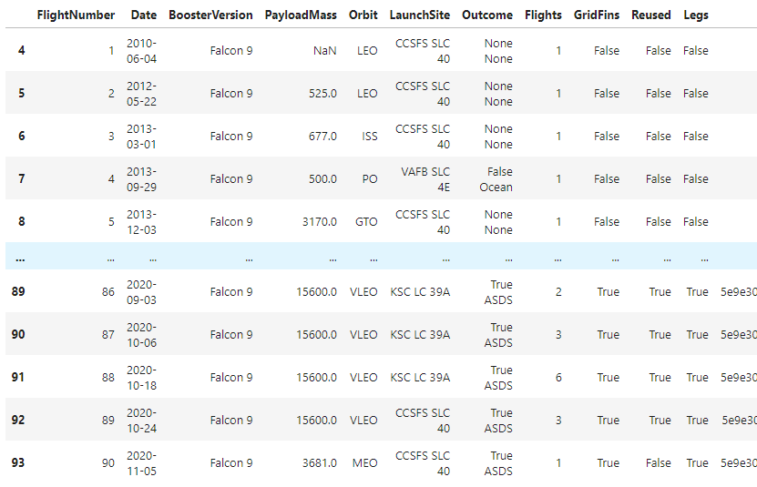
Data Collection – SpaceX API
https://github.com/[...]spacex-data-collection-api.ipynb
Request and parse the SpaceX launch data
GET request to https://api.spacexdata.com/v4/launches/past
Convert result into a Pandas dataframe using pd.json_normalize()
Request and parse detailed launch information
Using the launch ID’s get detailed data for each rocket launch. For each feature create a list.
Finally create a new dataframe with the combined information
Data Wrangling -
filter data
Filter on “Falcon 9” launches
Partial picture of the final dataframe
Data Wrangling – identify and deal with missing values.
Replace missing “Payload Mass” values with its mean
Save dataframe to CSV file.

Slide 10
Data Collection - Scraping
Present your web scraping process using key phrases and flowcharts
Add the GitHub URL of the completed web scraping notebook, as an external reference and peer-review purpose
Place your flowchart of web scraping here

Slide 11
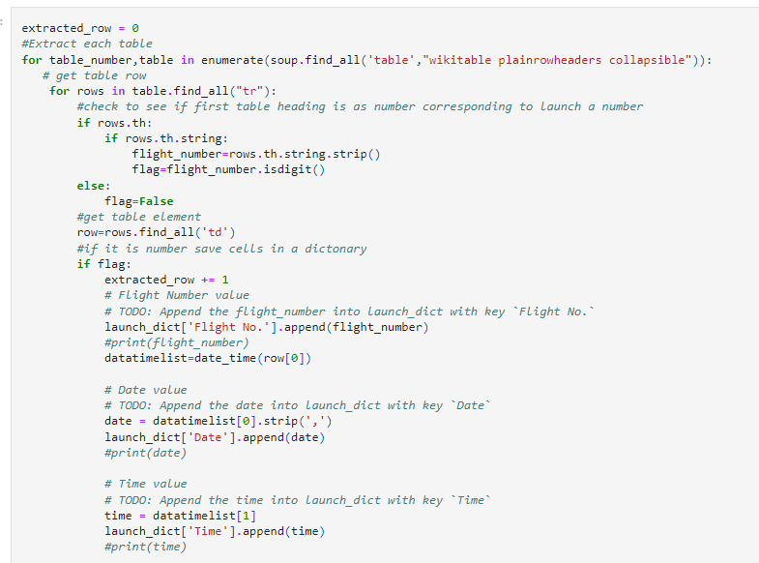
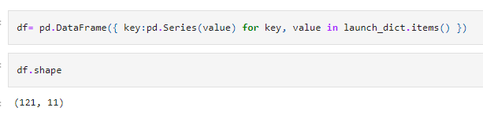
Data Collection - Scraping
https://github.com/[...]labs-webscraping.ipynb
Request the Falcon9 Launch Wiki page from its URL
Extract a Falcon 9 launch records HTML table from Wikipedia
Extract all column/variable names from the HTML table header
(starting from the third table)
Create an empty dictionary with keys from the extracted column names
Partial picture of the parsing process using a launch_dict dictionary
Parse the table and convert it into a Pandas data frame
Create a data frame by parsing the launch HTML tables stored in the dictionary launch_dict
Picture of the final dataframe shape
Save dataframe to CSV file.
11

Slide 12
Data Wrangling
Describe how data were processed
You need to present your data wrangling process using key phrases and flowcharts
Add the GitHub URL of your completed data wrangling related notebooks, as an external reference and peer-review purpose
https://github.com/[...] spacex-Data%20wrangling.ipynb

Slide 13
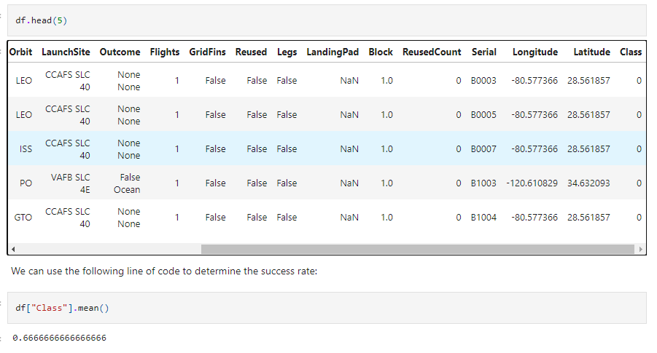
Data Wrangling
https://github.com/[...] spacex-Data%20wrangling.ipynb
Data Analysis
Identify missing values in each attribute
Identify numerical and categorical columns
Calculate the number of launches on each site
Calculate the number and occurrence of each orbit
Partial picture of the final data frame with an additional outcome label named class
Calculate the number and occurrence of mission outcome of the orbits
Create a landing outcome label
Create a landing outcome label from Outcome column, a bad outcome=0, otherwise 1
Save dataframe to CSV file
13
13

Slide 14
EDA with SQL
Using bullet point format, summarize the SQL queries you performed
Add the GitHub URL of your completed EDA with SQL notebook, as an external reference and peer-review purpose

Slide 15
EDA with SQL
https://github.com/[...] eda-sql-coursera_sqllite.ipynb
Summarize the SQL queries you performed:
Names of unique launch sites
5 records where launch sites begin with the string 'CCA’
Total payload mass carried by boosters launched by ‘NASA (CRS)’
Average payload mass carried by booster version ‘F9 v1.1’
Date when the first successful landing outcome in ground pad was achieved.
Names of the boosters which have success in drone ship and have payload mass greater than 4000 but less than 6000
Total number of successful and failure mission outcomes
Names of the booster versions which have carried the maximum payload mass.
Records which will display the month names, failure landing outcomes in drone ship, booster versions, launch site for the months in year 2015
Rank the count of landing outcomes (such as Failure (drone ship) or Success (ground pad) between the date 2010-06-04 and 2017-03-20, in descending order.

Slide 16
EDA with Data Visualization
Summarize what charts were plotted and why you used those charts
Add the GitHub URL of your completed EDA with data visualization notebook, as an external reference and peer-review purpose

Slide 17
EDA with Data Visualization
https://github.com/[...] eda dataviz.ipynb
Summarize what charts were plotted and why you used those charts:
Visualize how the Flight Number (indicating the continuous launch attempts.) and Payload variables would affect the launch outcome. Plot a scatter point chart ‘Flight Number’ vs. ‘Payload Mass’ and overlay the outcome of the launch.
Visualize the relationship between Flight Number and Launch Site. Plot a scatter point chart ‘Flight Number’ vs. ‘Launch Site’, and hue to be the ‘class’ value (overlay of the outcome of the launch)
Visualize the relationship between Payload Mass and Launch Site. Plot a scatter point chart ‘Pay Load Mass (kg)’ vs. ‘Launch Site’, and hue to be the ‘class’ value (overlay of the outcome of the launch)
Visualize the relationship between success rate of each orbit type. Plot a bar chart ‘Orbit’ vs. ‘Class’ mean, grouped by ‘Orbit’
Visualize the relationship between Flight Number and Orbit type. Plot a scatter point chart ‘Flight Number’ vs. ‘Orbit’, and hue to be the class value
Visualize the relationship between Payload Mass and Orbit type. Plot a scatter point chart ‘Payload Mass’ vs. ‘Orbit’, and hue to be the class value
Visualize the launch success yearly trend. Plot a line chart ‘Year’ vs ‘Class’ sum, grouped by ‘Year’

Slide 18
Build an Interactive Map with Folium
Summarize what map objects such as markers, circles, lines, etc. you created and added to a folium map
Explain why you added those objects
Add the GitHub URL of your completed interactive map with Folium map, as an external reference and peer-review purpose

Slide 19
Build an Interactive Map with Folium
https://github.com/[...] site_location.ipynb
Summarize what map objects such as markers, circles, lines, etc. you created and added to a folium map:
Using folium.Circle and folium.Marker marked each launch site on a map, to visualize their location. Labeled the site name using folium.Popup.
Marked the success/failed launches for each site using a green or red marker
Calculated the distances between a launch site to its proximities, using folium.PolyLine drew lines between points and labeled the distance using folium.Popup.
Explain why you added those objects:
Having identified and labeled on the map each launch sites, the outcome of each rocked launch, and the distance to notable points in their proximities, we can identity patterns and create hypothesis to test .e.g.:
Nearest coastline: 1km
Nearest railway: 1km
Nearest highway: ~24 km
Nearest airport: ~15 km

Slide 20
Build a Dashboard with Plotly Dash
Summarize what plots/graphs and interactions you have added to a dashboard
Explain why you added those plots and interactions
Add the GitHub URL of your completed Plotly Dash lab, as an external reference and peer-review purpose

Slide 21
Build a Dashboard with Plotly Dash
https://github.com/[...] spacex_dash_app.py
Summarize what plots/graphs and interactions you have added to a dashboard:
Created a dropdown button to select ALL or a single launch site. Created a linked pie chart to show the successful launches per site (when “all” sites are selected), or to show the success/fail proportion (when a single site is selected).
Created a payload range selector between 0 Kg and 10,000 Kg. Created a linked scatter chart to show the relationship between outcome and payload for the different booster versions. This chart allows an interactive and dynamic analysis of relationship between outcome, payload and booster version.

Slide 22
Predictive Analysis (Classification)
Summarize how you built, evaluated, improved, and found the best performing classification model
You need present your model development process using key phrases and flowchart
Add the GitHub URL of your completed predictive analysis lab, as an external reference and peer-review purpose

Slide 23
Predictive Analysis (Classification)
https://github.com/[...] MachineLearningPrediction_Part_5.ipynb
Summarize how you built, evaluated, improved, and found the best performing classification model:
Performed exploratory Data Analysis and determined Training Labels:
created an array from the landing outcome “class”
standardized the data
split data into training data and test data
Using the GridSearchCV, found the best hyperparameter for Logistic Regression, SVM, Decision Tree and K-Nearest Neighbors.
Using the test data, applied the method score to determine the model accuracy and plotted a confusion matrix to evaluate and compare the models.
Exploratory Data Analysis
and
Training Labels
Load csv file to dataframe. Create a NumPy array from the column Class.
Standardize the data in X then reassign it to the variable X using the transform StandardScaler()
Use the function train_test_split to split the data X and Y into training and test data
Create a logistic regression object then create a GridSearchCV object
Fit the model’s object to find the best parameters from the dictionary parameters
Evaluate each model
We display the best parameters using the data attribute best_params_ and the accuracy on the validation data using the data attribute best_score_
Calculate the accuracy on the test data using the method score
Plot the confusion matrix

Slide 24
Results
Exploratory data analysis results
Interactive analytics demo in screenshots
Predictive analysis results

Slide 25

Section 2

Slide 26
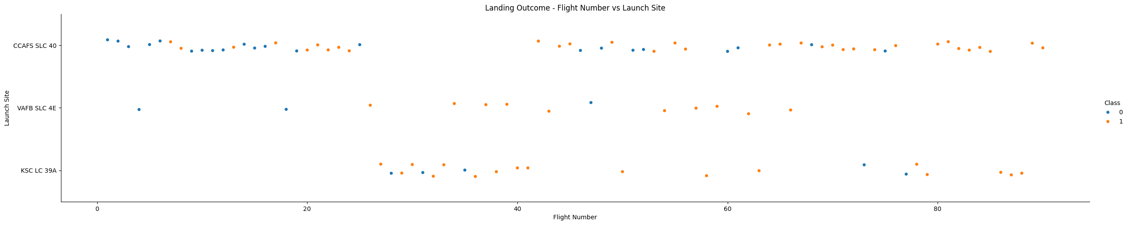
Flight Number vs. Launch Site
With time (seen by the flight number), the success rate increased at all sites

Slide 27
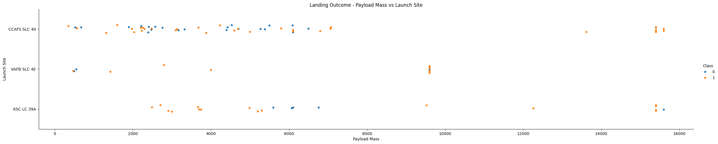
Payload vs. Launch Site
At CCAFS SLC 40 the success rate is mixed at low payloads (less than 8000), no pattern. However, at heavy load around 15500 the success rate is very high.
At VAFB-SLC 4E there are no rockets launched for heavy payload mass (greater than 10000). At the highest payload around 9600, the success rate is very high.
At KSC LC 39A there is a range between ~5500 and 7000 where the success rate is null, however outside that range, the success rate is high.

Slide 28
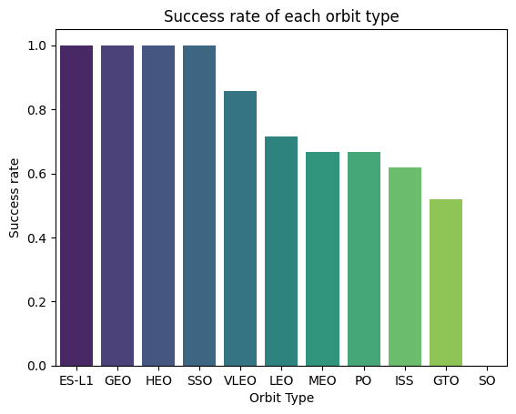
Success Rate vs. Orbit Type
Orbits ES-L1, GEO, HEO and SSO have the highest success rate.

Slide 29
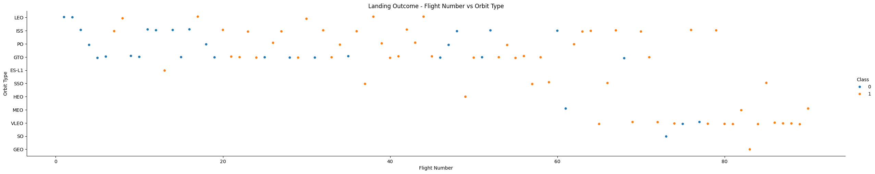
Flight Number vs. Orbit Type
In the LEO orbit, success seems to be related to the number of flights.
In the GTO orbit, there appears to be no relationship between flight number and success.
SSO had few launches but is has a 100% success rate
VLEO has a high success rate and was the preferred launch pad in the later launches.

Slide 30
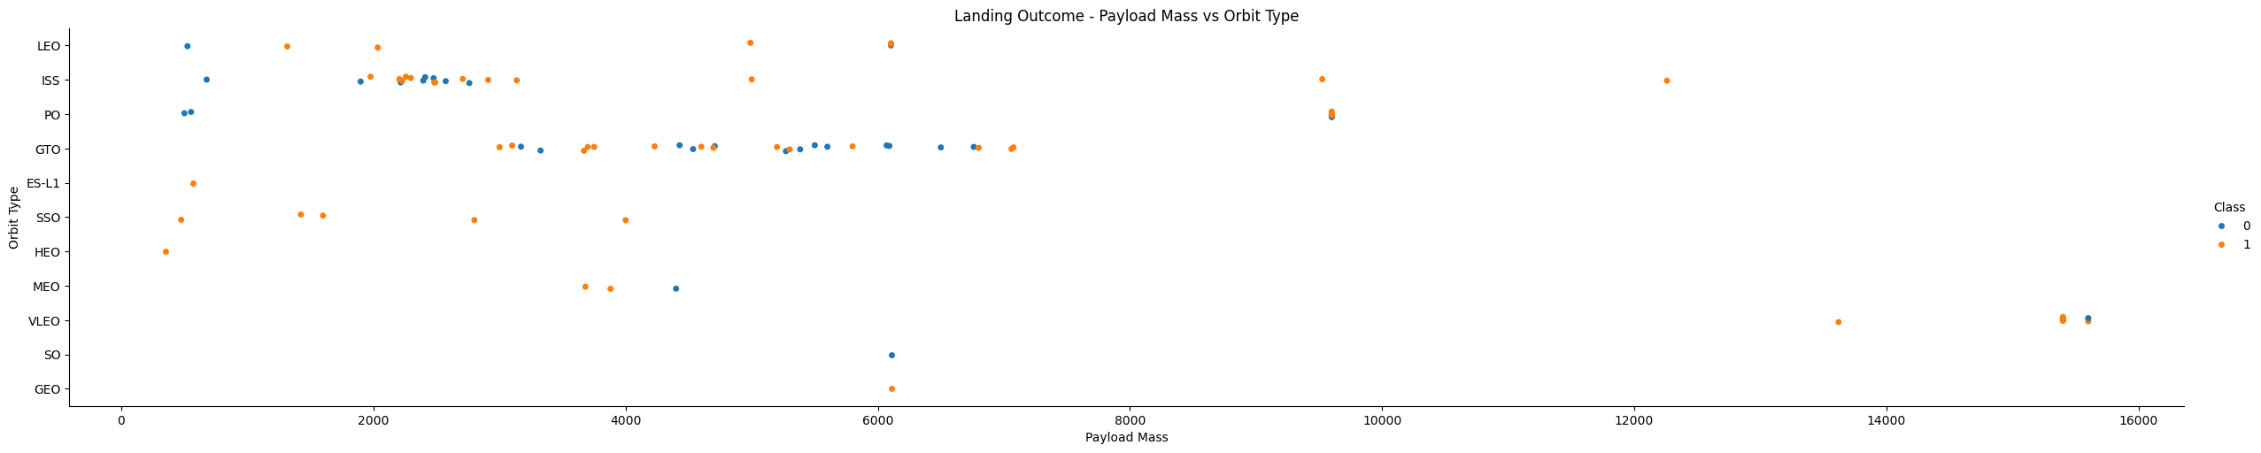
Payload vs. Orbit Type
With heavy payloads the successful landing rate is higher for LEO, PO and ISS.
For GTO, it's difficult to distinguish between successful and unsuccessful landings as both outcomes are present.

Slide 31
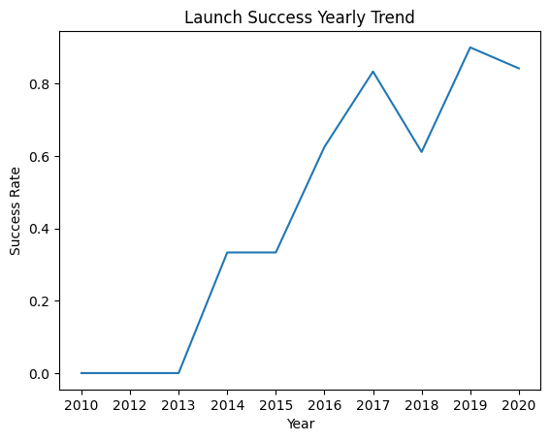
Launch Success Yearly Trend
Success rate increased since 2013 until it picked in 2017
Then the success rate decreased slightly in 2018
In later years success rate was about 80%

Slide 32
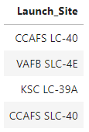
All Launch Site Names
Query:
DISTINCT clause is used in the query to select only unique values
There are four unique launch sites:
select distinct Launch_Site
from SPACEXTABLE

Slide 33
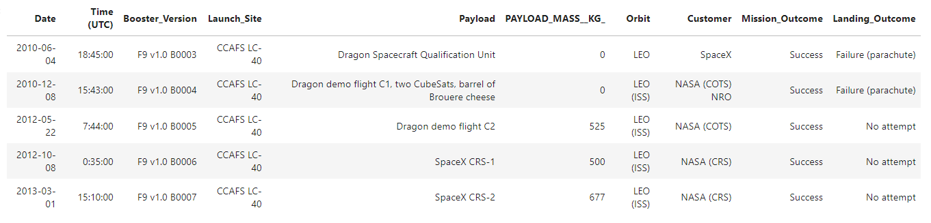
Launch Site Names Begin with 'CCA'
Find 5 records where launch sites begin with `CCA` - query:
Use of LIKE ‘CCA%’ ensures the Launch_Site begins with ‘CCA’. Use of LIMIT 5 outputs only 5 records.
select * from SPACEXTABLE
where Launch_Site like 'CCA%’
limit 5

Slide 34
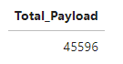
Total Payload Mass
Calculate the total payload carried by boosters from NASA – query:
Use of SUM("PAYLOAD_MASS__KG_") calculates the sum of the payload of all records WHERE customer ='NASA (CRS)’ condition is true.
select sum("PAYLOAD_MASS__KG_") Total_Payload from SPACEXTABLE
where customer ='NASA (CRS)'

Slide 35
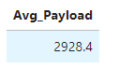
Average Payload Mass by F9 v1.1
Calculate the average payload mass carried by booster version F9 v1.1- query:
Use of AVG("PAYLOAD_MASS__KG_") calculates the average of the payload of all records WHERE "Booster_Version" =‘F9 v1.1’ condition is true.
select AVG("PAYLOAD_MASS__KG_") Avg_Payload from SPACEXTABLE
where "Booster_Version" ='F9 v1.1'

Slide 36
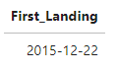
First Successful Ground Landing Date
Find the dates of the first successful landing outcome on ground pad – query:
Use of MIN(Date) function selected the earliest date, WHERE "Landing_Outcome" ='Success (ground pad)’ condition was true.
select min(Date) First_Landing from SPACEXTABLE
where "Landing_Outcome" ='Success (ground pad)'

Slide 37
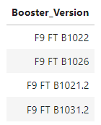
Successful Drone Ship Landing with Payload between 4000 and 6000
List the names of boosters which have successfully landed on drone ship and had payload mass greater than 4000 but less than 6000
Use of DISTINCT ensured only unique values were selected. The WHERE condition ensured that only "Landing_Outcome" ='Success (drone ship)’ were included and limited the payload to the desired range ("PAYLOAD_MASS__KG_">4000) AND ("PAYLOAD_MASS__KG_"<6000)
select distinct Booster_Version from SPACEXTABLE
where "Landing_Outcome" ='Success (drone ship)’ and ("PAYLOAD_MASS__KG_">4000) and ("PAYLOAD_MASS__KG_"<6000)

Slide 38
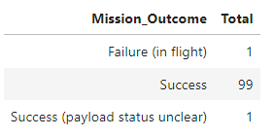
Total Number of Successful and Failure Mission Outcomes
Calculate the total number of successful and failure mission outcomes
Combining the use of COUNT(*) with GROUP BY outputs the count of the field in the group by Mission_Outcome or RTRIM(Mission_Outcome).
Use of RTRIM was used to remove an extra “space” existent in one “Success “ entry
select rtrim(Mission_Outcome) Mission_Outcome, count(*) Total from SPACEXTABLE
Group by rtrim(Mission_Outcome)

Slide 39
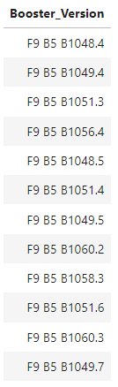
Boosters Carried Maximum Payload
List the names of the booster which have carried the maximum payload mass – query:
This is a 2-step query performed using a sub-query:
SELECT MAX("PAYLOAD_MASS__KG_") FROM SPACEXTABLE
This sub-query retrieves the maximum value of the payload. The result is used as input for the WHERE condition on the main query:
WHERE "PAYLOAD_MASS__KG_" =
select Booster_Version from SPACEXTABLE
where "PAYLOAD_MASS__KG_" = (select max("PAYLOAD_MASS__KG_") from SPACEXTABLE)

Slide 40
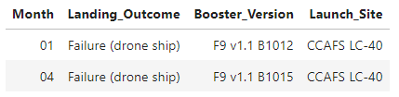
2015 Launch Records
List the failed landing_outcomes in drone ship, their booster versions, and launch site names for in year 2015
The function SUBSTR(Date, 6,2) retrieves the month from the Date field.
Similarly, in the WHERE condition, using SUBSTR(Date,0,5)='2015’ ensures we only select the year 2015. Finally, we ensure "Landing_Outcome"='Failure (drone ship)'
select substr(Date, 6,2) Month, Landing_Outcome, Booster_Version ,Launch_Site from SPACEXTABLE where substr(Date,0,5)='2015' and "Landing_Outcome"='Failure (drone ship)'

Slide 41
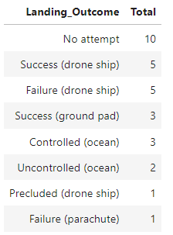
Rank Landing Outcomes Between 2010-06-04 and 2017-03-20
Rank the count of landing outcomes (such as Failure (drone ship) or Success (ground pad) between the date 2010-06-04 and 2017-03-20, in descending order – query:
select Landing_Outcome, count(Landing_Outcome) Total from SPACEXTABLE
where Date>'2010-06-04' and Date<'2017-03-20’
group by Landing_Outcome
order by Total desc
COUNT(Landing_Outcome) Total defines the aggregation function and the field used, ‘Total’ is the name of the new column.
Condition WHERE Date>'2010-06-04’ AND Date<'2017-03-20’ selects only results in the data range desired.
GROUP BY Landing_Outcome allows the aggregation of the count results by Landing_Outcome
ORDER BY Total DESC lists results in descending order of the count “Total”

Slide 42

Section 3

Slide 43
<Folium Map Screenshot 1>
Replace <Folium map screenshot 1> title with an appropriate title
Explore the generated folium map and make a proper screenshot to include all launch sites’ location markers on a global map
Explain the important elements and findings on the screenshot

Slide 44
<Folium Map Screenshot 2>
Replace <Folium map screenshot 2> title with an appropriate title
Explore the folium map and make a proper screenshot to show the color-labeled launch outcomes on the map
Explain the important elements and findings on the screenshot

Slide 45
<Folium Map Screenshot 3>
Replace <Folium map screenshot 3> title with an appropriate title
Explore the generated folium map and show the screenshot of a selected launch site to its proximities such as railway, highway, coastline, with distance calculated and displayed
Explain the important elements and findings on the screenshot

Slide 46

Section 4

Slide 47
<Dashboard Screenshot 1>
Replace <Dashboard screenshot 1> title with an appropriate title
Show the screenshot of launch success count for all sites, in a piechart
Explain the important elements and findings on the screenshot

Slide 48
<Dashboard Screenshot 2>
Replace <Dashboard screenshot 2> title with an appropriate title
Show the screenshot of the piechart for the launch site with highest launch success ratio
Explain the important elements and findings on the screenshot

Slide 49
<Dashboard Screenshot 3>
Replace <Dashboard screenshot 3> title with an appropriate title
Show screenshots of Payload vs. Launch Outcome scatter plot for all sites, with different payload selected in the range slider
Explain the important elements and findings on the screenshot, such as which payload range or booster version have the largest success rate, etc.

Slide 50

Section 5

Slide 51
Classification Accuracy
Visualize the built model accuracy for all built classification models, in a bar chart
Find which model has the highest classification accuracy

Slide 52
Confusion Matrix
Show the confusion matrix of the best performing model with an explanation

Slide 53
Conclusions
Point 1
Point 2
Point 3
Point 4
…

Slide 54
Appendix
Include any relevant assets like Python code snippets, SQL queries, charts, Notebook outputs, or data sets that you may have created during this project

Slide 55


